Slide 1


Diabetic Retinopathy Prediction In Patients
Group 5:
Madduri Spandhana
Mitali Dinesh Aswale
Afiya Mohammed Rafi
Sai Madhav Aluru
Ankur Singh
Tukkayagari Manasa

Slide 2
Objective:
To develop a binary classification model that accurately predicts the presence or absence of diabetic retinopathy in patients, using relevant medical and diagnostic data, enabling early detection and proactive treatment.

Slide 3
Problem Statement:
Diabetic retinopathy is one of the major causes of blindness in working-age adults.
It develops due to damage to blood vessels in the retina caused by prolonged high blood sugar.
Often, symptoms appear late, so early detection is critical.
Manual detection requires resources — we aim to create an automated and accessible prediction tool.
.

Slide 4
Diabetic Retinopathy :
Caused by prolonged high blood sugar in people with diabetes.
Damages the blood vessels in the retina.
Leading cause of blindness in working-age adults.
Risk factors: High blood sugar, High blood pressure, High cholesterol.
Early treatment can prevent severe vision loss.
Screening and prediction tools can make early detection easier.

Slide 5
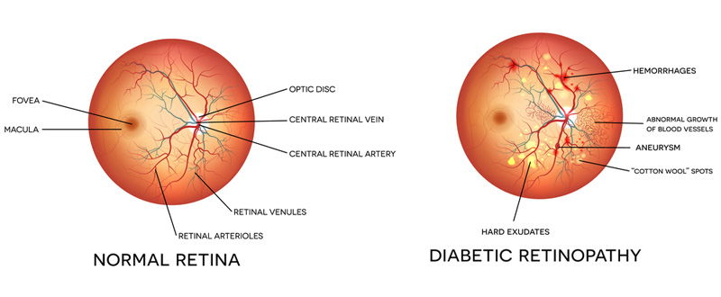
Difference between Normal Retina and Retina with Diabetic Retinopathy

Slide 6
Dataset Details:
Target variables has two values in a classification project type: 0 (false) or 1 (true).
The number of instances (rows) in the data set is 6000.
The number of variables (columns) is 6.
The information of the variables available in the dataset:
1)ID: Unique id for each patient
2)Age: Represent age of the patient.
3)systolic_bp: (normal range: below 120mmHg).
When the heart beats, it squeezes and pushes blood through the arteries to the rest of the body.
This force creates pressure on the blood vessels, and that is the systolic blood pressure.
Systolic blood pressure (upper value in a BP reading).

Slide 7
Dataset Details:
4)diastolic_bp: (normal range: lower than 80mmHg). It is the pressure in the arteries when the heart rests between beats.
This is the time when the heart fills with blood and gets oxygen.
– Diastolic blood pressure (lower value in a BP reading).
5)cholesterol: (normal range: between 125 and 200 mg/dl).
It is a waxy, fat-like substance found in every cell in the body.
6)prognosis: The likely outcome or course of a disease.(0 or 1) (Target)
It is 1 if the patient has retinopathy and 0 if he/she doesn't.
The main challenges:
Values stored together in a single column separated by “;”.
Incorrect data types for several variables.
Th

Slide 8
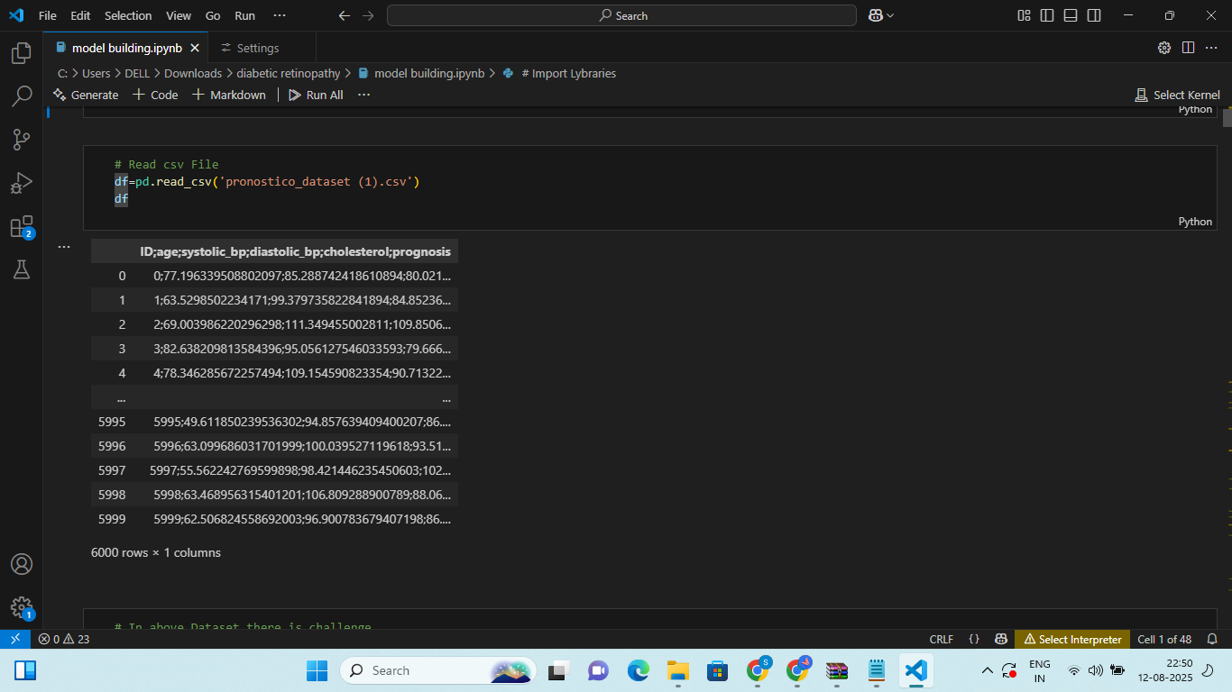
Exploratory Data Analysis:
Loading the dataset :

Slide 9
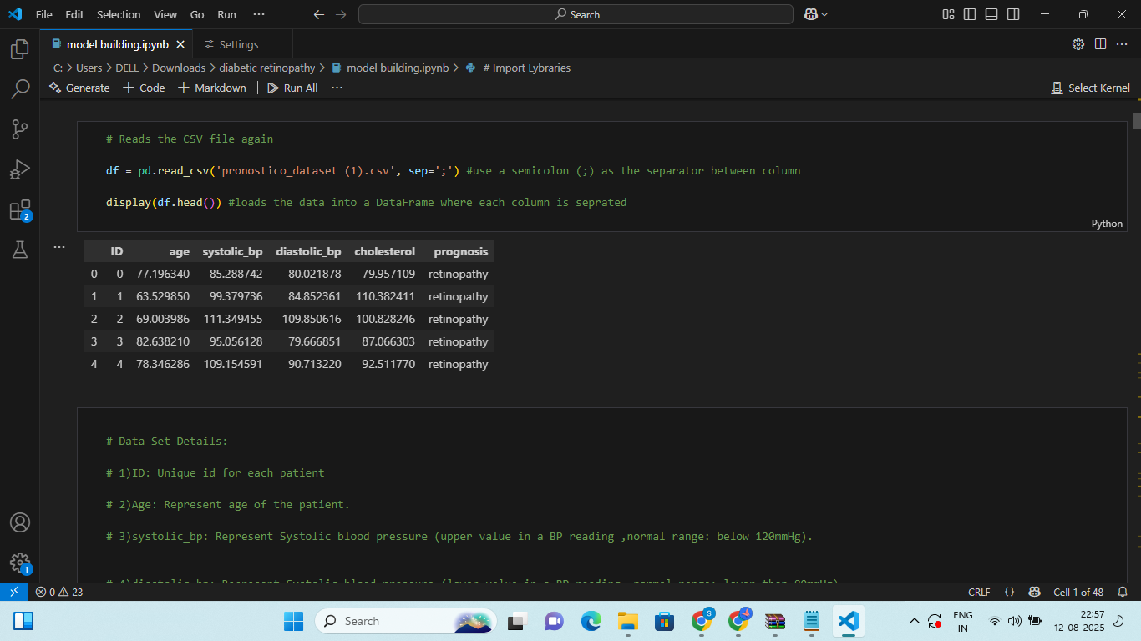
Separating the values using ';' :

Slide 10
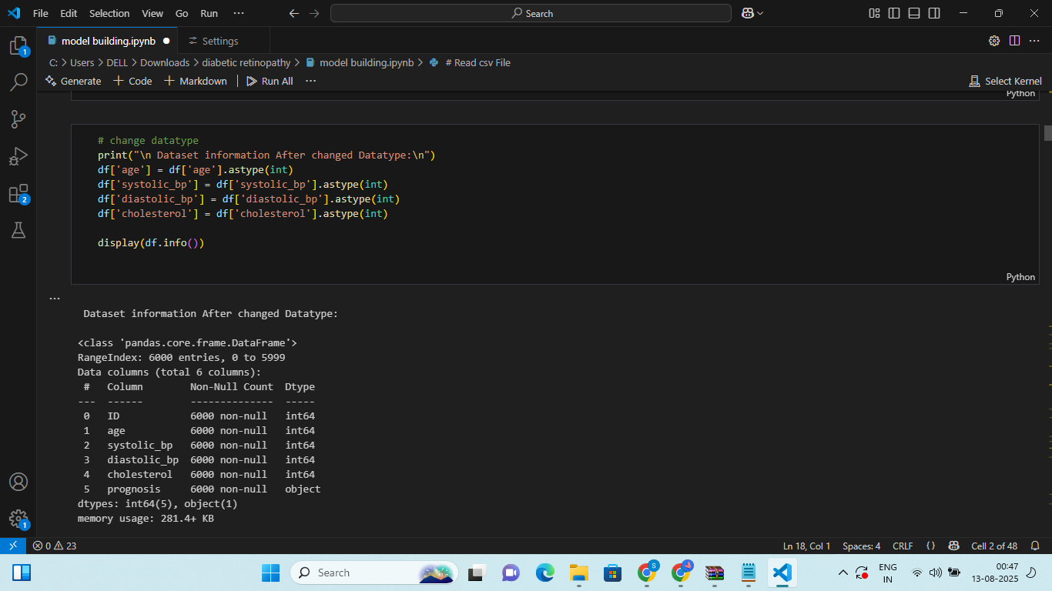
Converting the datatypes:

Slide 11
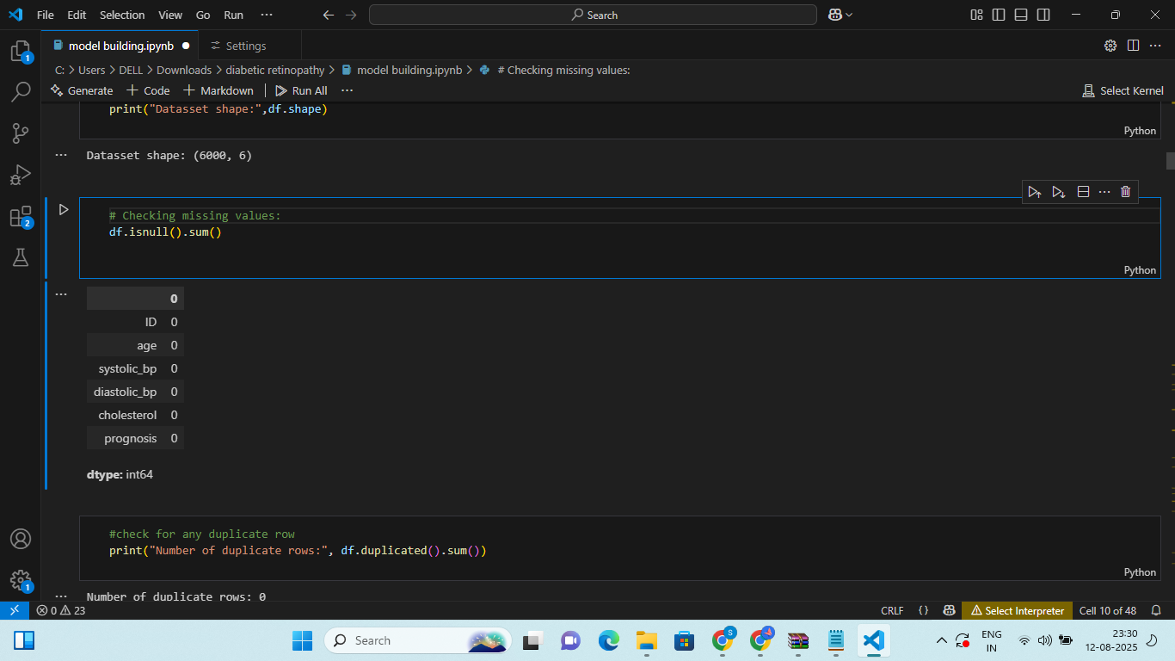
4
Checking for missing values:
There were no missing values present in the dataset.

Slide 12
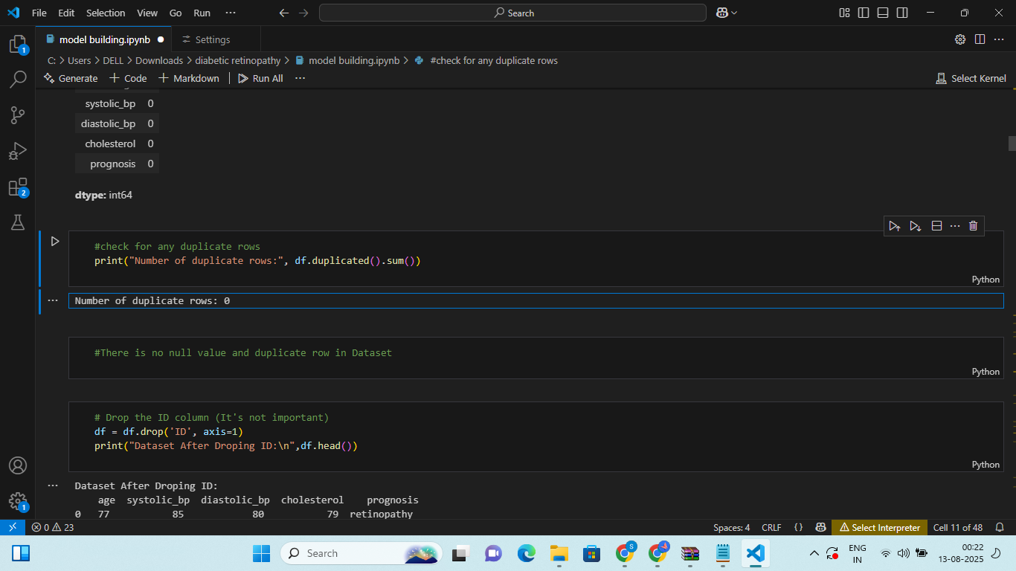
4
Checking for Duplicate rows:
There were no duplicate rows present in the dataset.

Slide 13
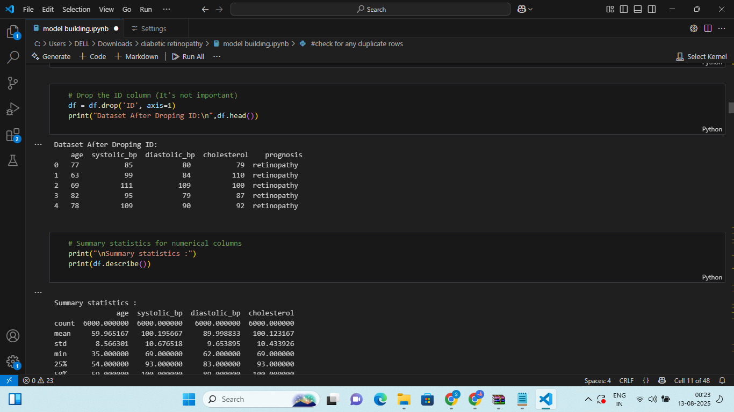
4
Dropping ID:
As ID is a unique identifier and has no predictive value we're dropping it.

Slide 14
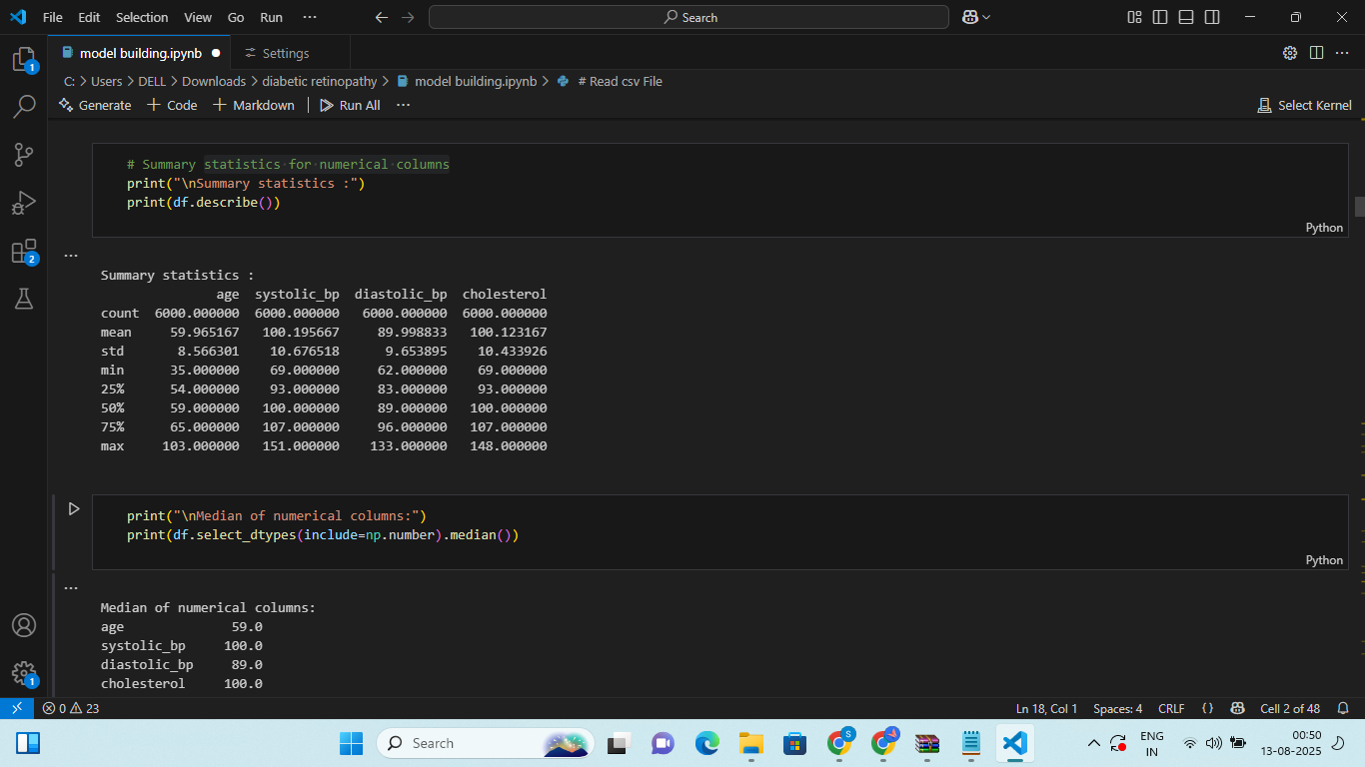
4
Data Statistics for numerical columns:
Age and all clinical parameters have close mean and median values, indicating near-symmetrical distributions.
Standard deviations are relatively small, suggesting low variability within the dataset.

Slide 15
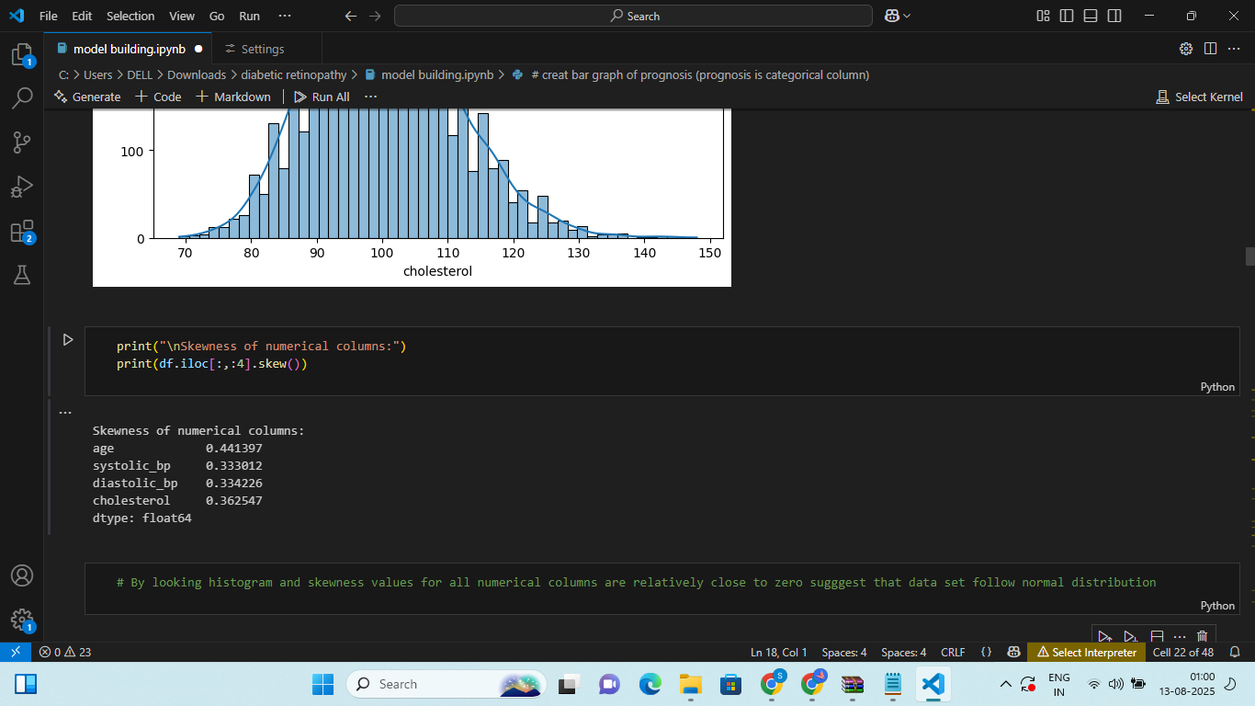
4
Skewness of the numerical columns:
Skewness values for all numerical columns are close to zero which indicating the data is nearly symmetric and follow normal distribution.

Slide 16
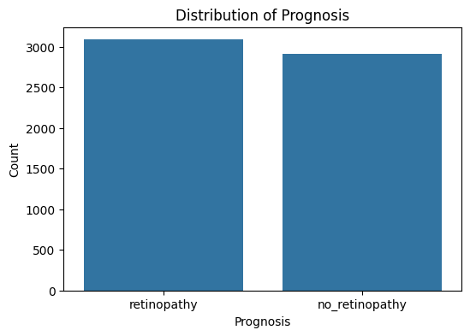
4
Distribution of Prognosis:

Slide 17
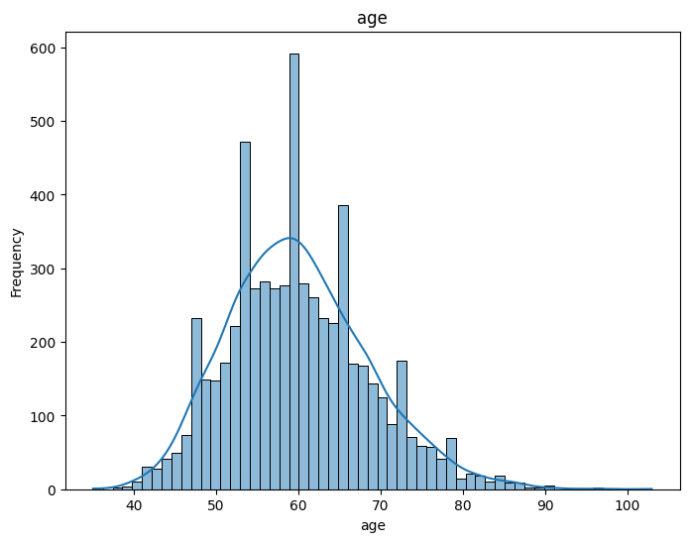
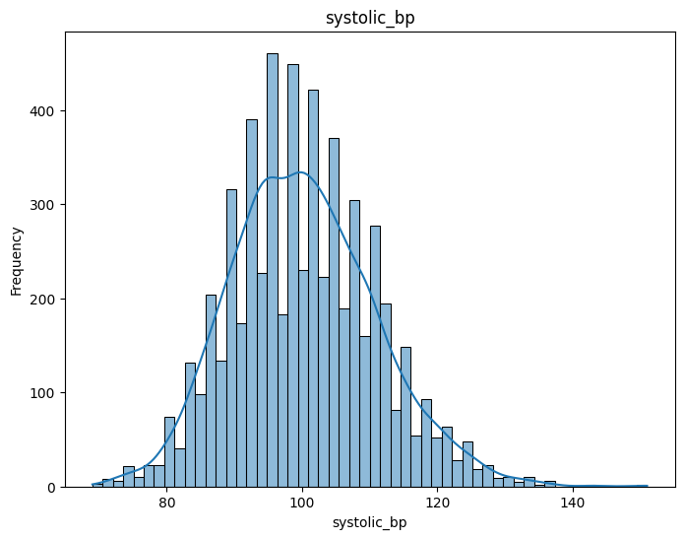
4
Histogram:
Age: Mostly between 50–70 years; slightly right-skewed.​
Systolic BP: Nearly normal distribution, centered ~100 mmHg.

Slide 18
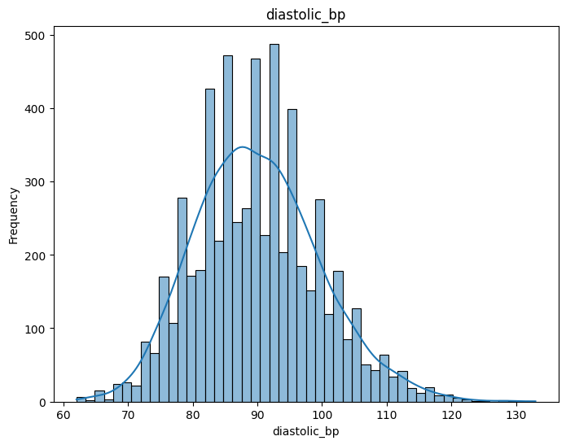
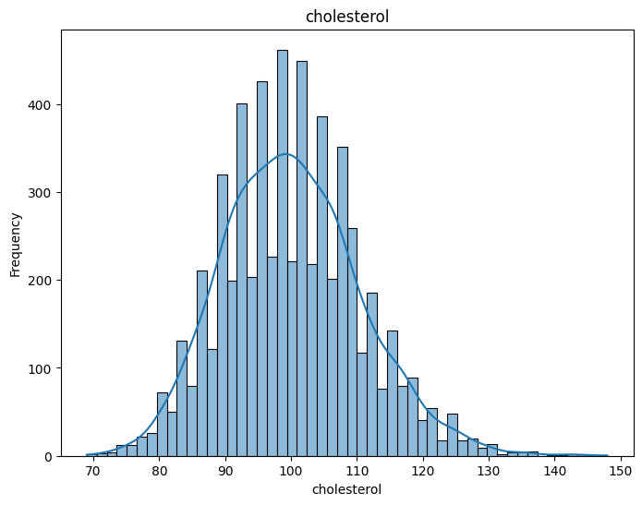
4
Histogram:
Diastolic BP: Symmetrical, centered around 95–105 mmHg.​​
Cholesterol: Bell-shaped, mostly between 90–110 mg/dL.​​
All variables show near-normal distribution

Slide 19
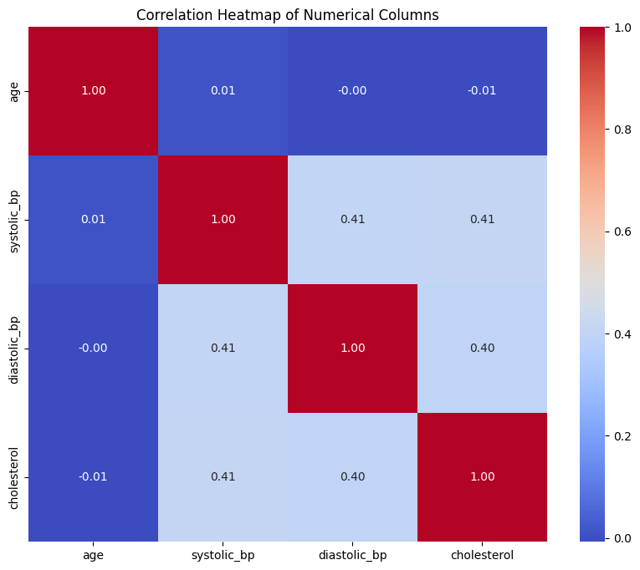
Correlation Heatmap:
Age shows almost no correlation with other numerical variables.
Systolic BP and Diastolic BP have a moderate positive correlation (0.41).
Systolic BP and Cholesterol also show moderate correlation (0.41).
Diastolic BP and Cholesterol have a moderate correlation (0.40).
No strong multicollinearity is detected.

Slide 20
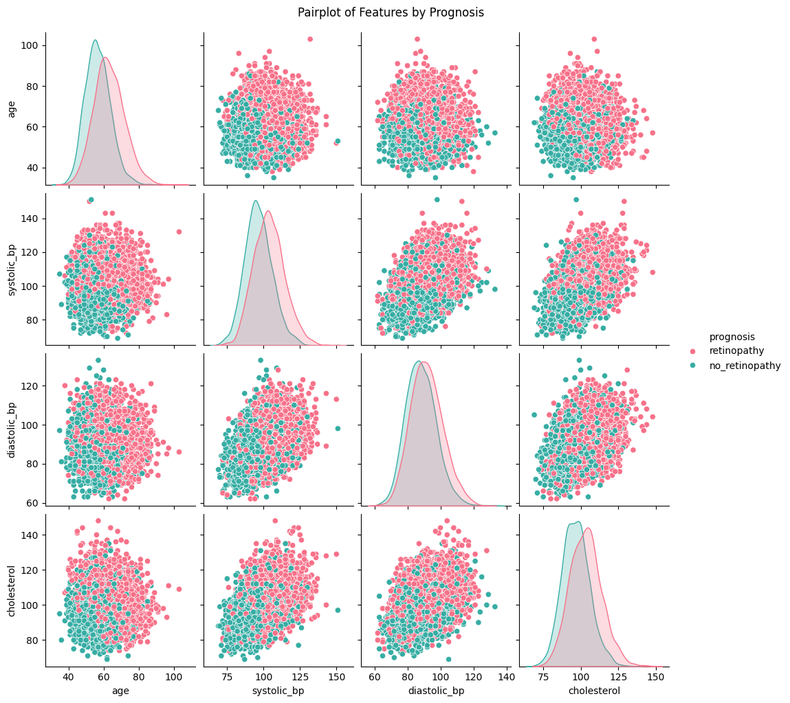
Pair Plots:
Age Distribution: Both groups have overlapping age ranges, with a slightly higher age concentration for retinopathy cases.
Systolic & Diastolic BP Relationship: higher systolic blood pressure generally comes with higher diastolic pressure, regardless of prognosis.
Blood Pressure & Cholesterol: Slight positive trend between BP (both systolic and diastolic) and cholesterol, more noticeable in the retinopathy group.
Cholesterol Distribution: Retinopathy patients tend to have slightly higher cholesterol levels than non-retinopathy patients.

Slide 21
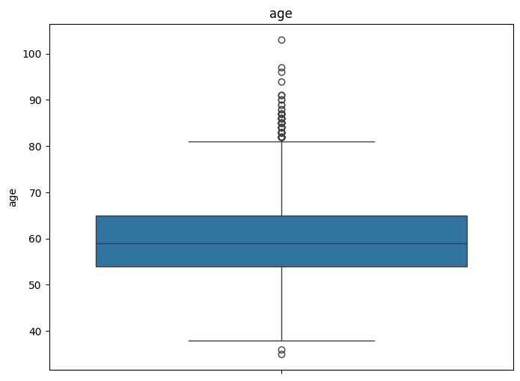
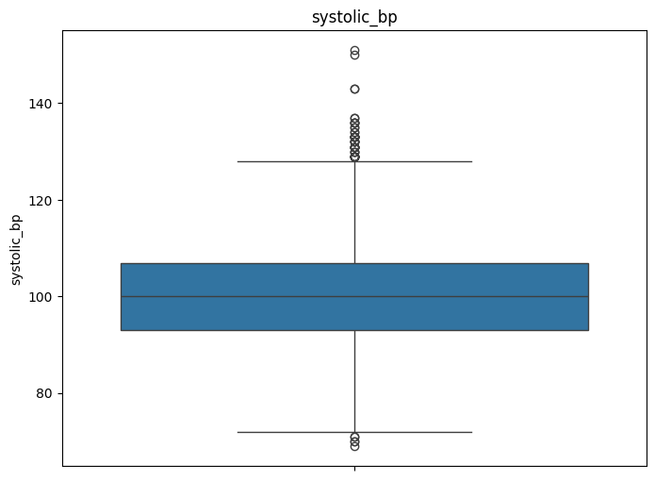


Box plots:

Slide 22
Insights from the boxplots:
Age: Median around 60 years.
Outliers present above 80 and below 40.
Systolic BP: Median around 100 mmHg.
Outliers above 120 and below 80.
Diastolic BP: Median around 90 mmHg.
Outliers above 115 and below 65.
Cholesterol: Median around 100.
Outliers present above 130 and below 75.

Slide 23
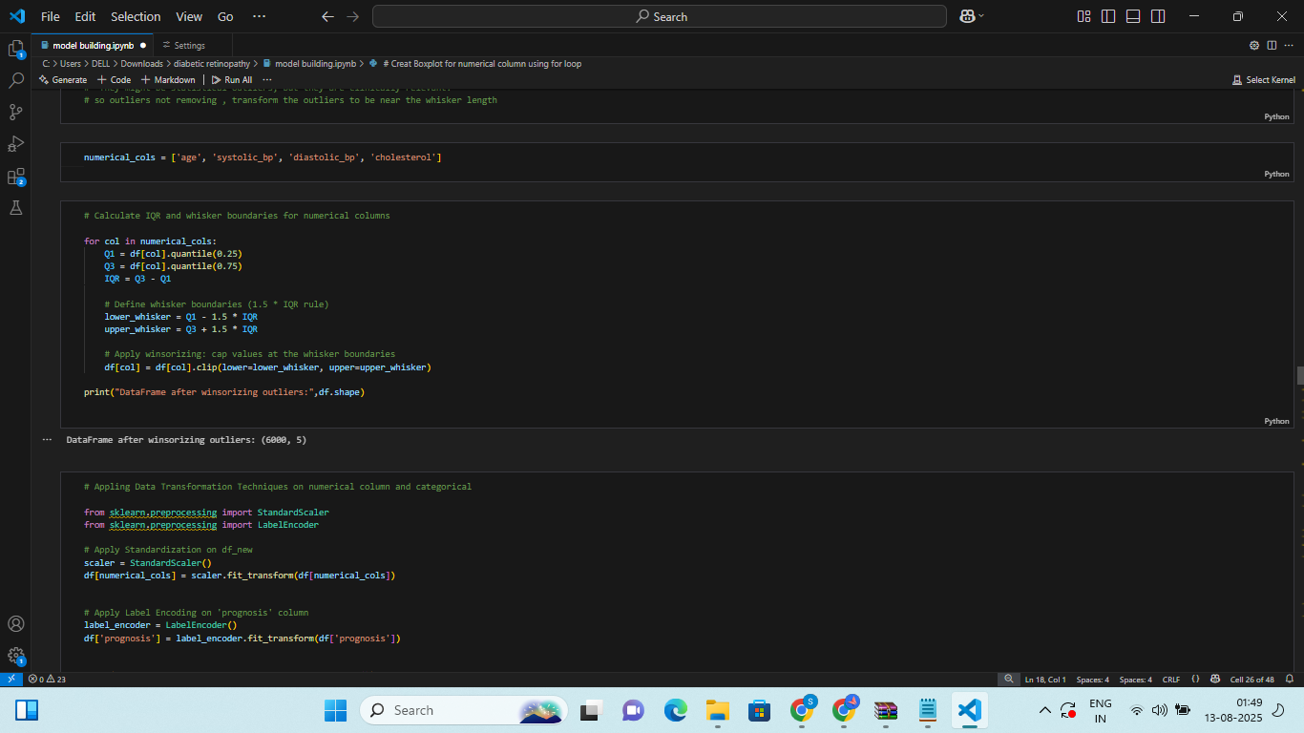
Handling Outliers to avoid extreme values distorting the results:
Outliers were handled using whisker-based approach (IQR method).

Slide 24
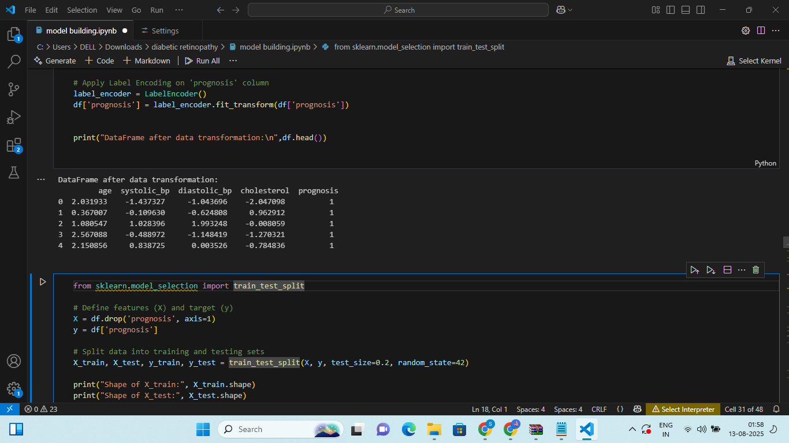
Data Transformation:
Shape the data so models can understand it better.

Slide 25
MODEL BUILDING:
Split the data into 80% training and 20% testing using train_test_split.
Used random_state=42 to ensure reproducible results.
We implemented and evaluated six machine learning models:
Logistic Regression,
Decision Tree,
AdaBoost
Support Vector Machine (SVM),
K-Nearest Neighbors (KNN)
Naive Bayes
Training and testing accuracies were compared to assess performance and detect overfitting or underfitting.
Logistic Regression, AdaBoost, and SVM achieved balanced performance between training and testing.
Decision Tree showed the highest training accuracy (0.79) but lower test accuracy (0.72), indicating possible overfitting.
SVM achieved the highest test accuracy (0.75), making it the best-performing model for this dataset.

Slide 26
MODEL BUILDING:
Models | Test Accuracy | Train Accuracy
Logistic Regression | 0.74 | 0.74
Decision Tree | 0.67 | 1.0
KNN | 0.76 | 0.76
Naïve Bayes | 0.74 | 0.73
AdaBoost | 0.75 | 0.74
SVM | 0.75 | 0.75

Slide 27
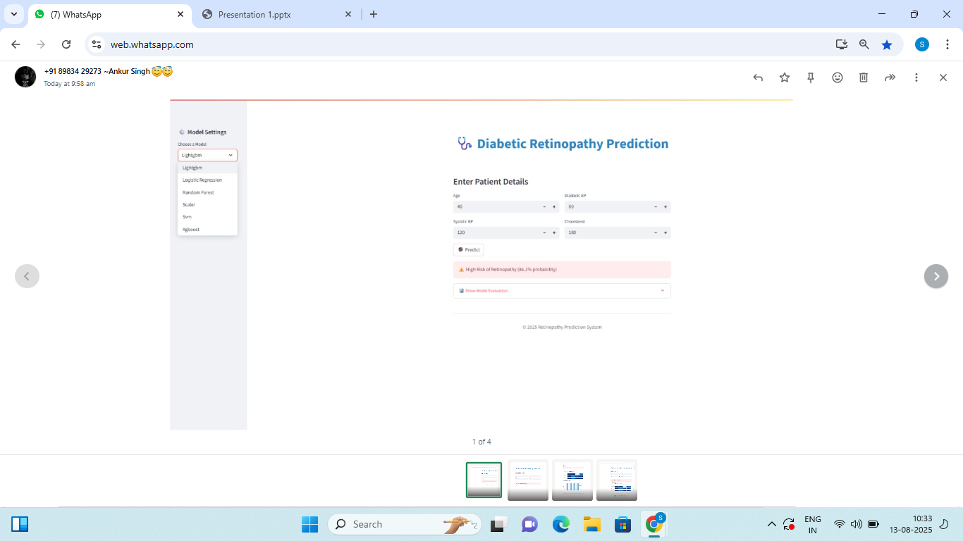
Deployment:

Slide 28
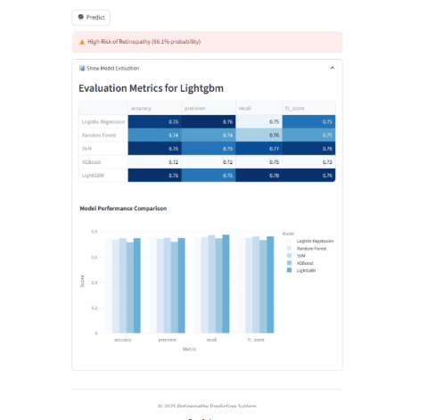
Deployment:

Slide 29
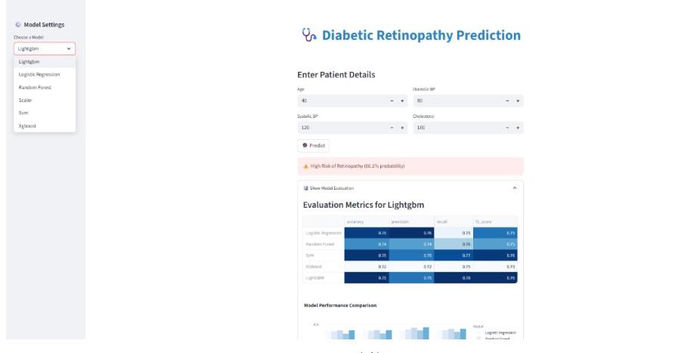
Deployment:

Slide 30
Limitation and Future Scope:
Limitations:
The model uses only four features, which limits prediction accuracy(75%).
Important clinical data such as HbA1c levels, duration of diabetes, and genetic information were not included.
The model’s performance may vary across different populations due to demographic differences.
Future Scope:
Adding more clinical and lifestyle features can improve the accuracy of predictions.
Training on larger and more diverse datasets can enhance model generalization.
The model can be integrated into hospital screening systems for early detection of diabetic retinopathy.
User-friendly tools can be developed to enable screenings in remote and rural areas.

Slide 31
Conclusion:
Successfully completed Exploratory Data Analysis (EDA), Model Building, and Model Deployment.
Conducted performance comparison across multiple machine learning models.
Support Vector Machine (SVM) achieved the best performance among all tested models.
The final model is capable of accurately predicting whether a patient has Diabetic Retinopathy or not.
This solution can assist in early diagnosis, enabling timely medical intervention and improved patient outcomes.

Slide 32


